Slide 1
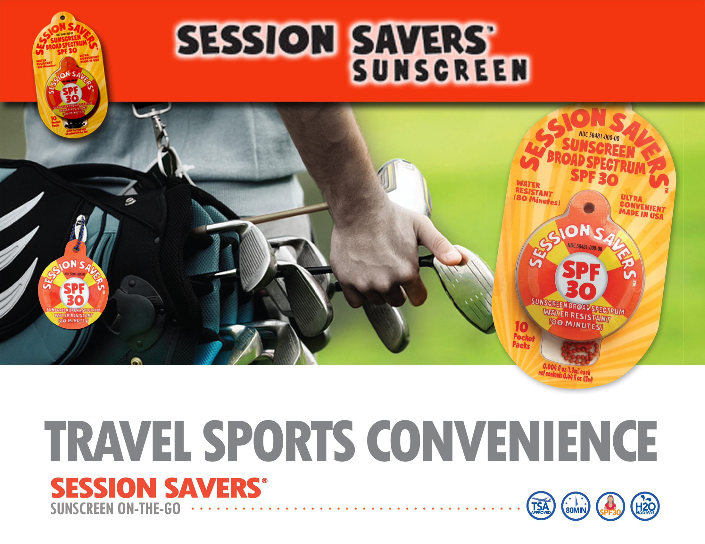

Slide 2
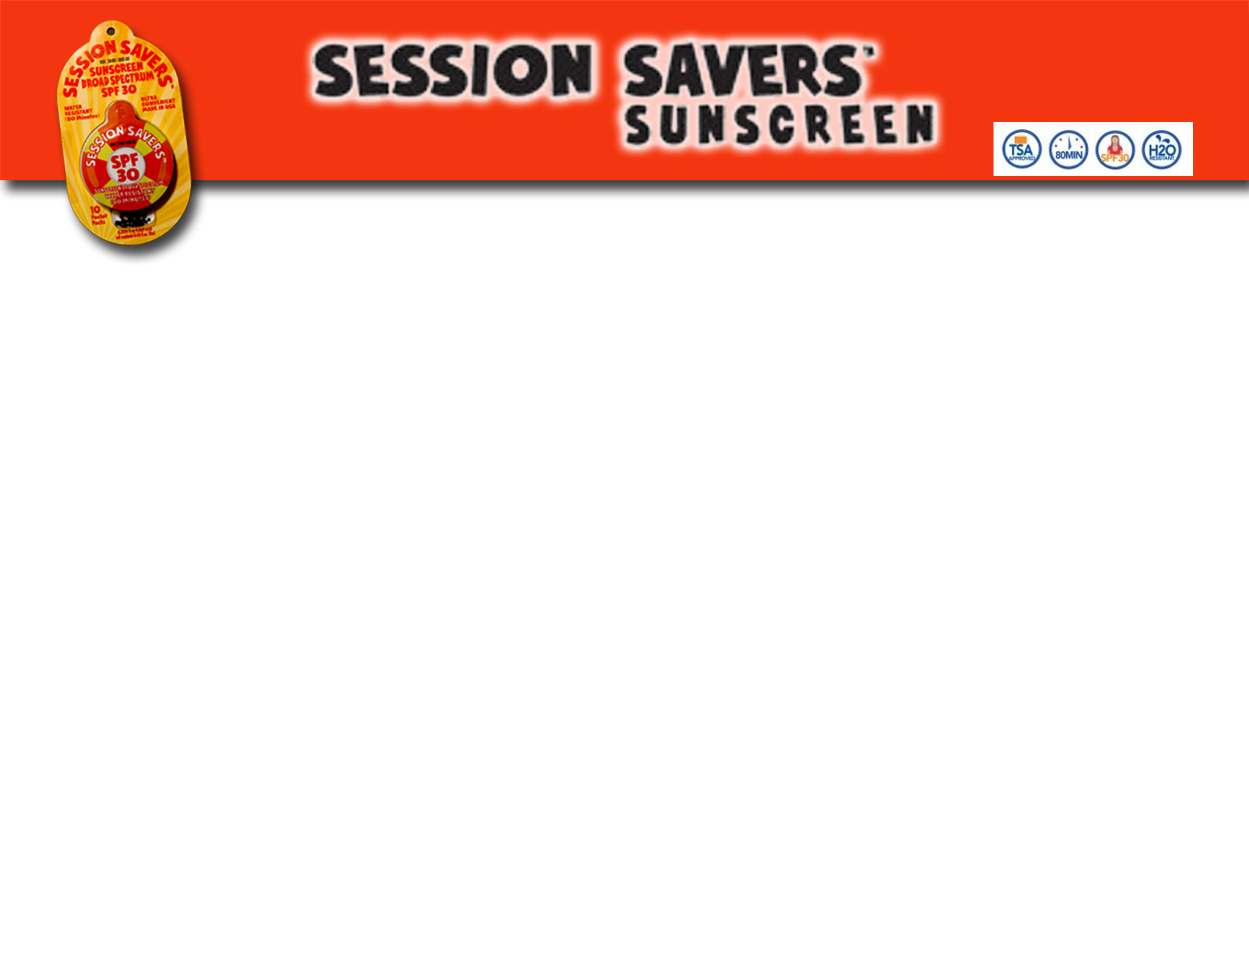
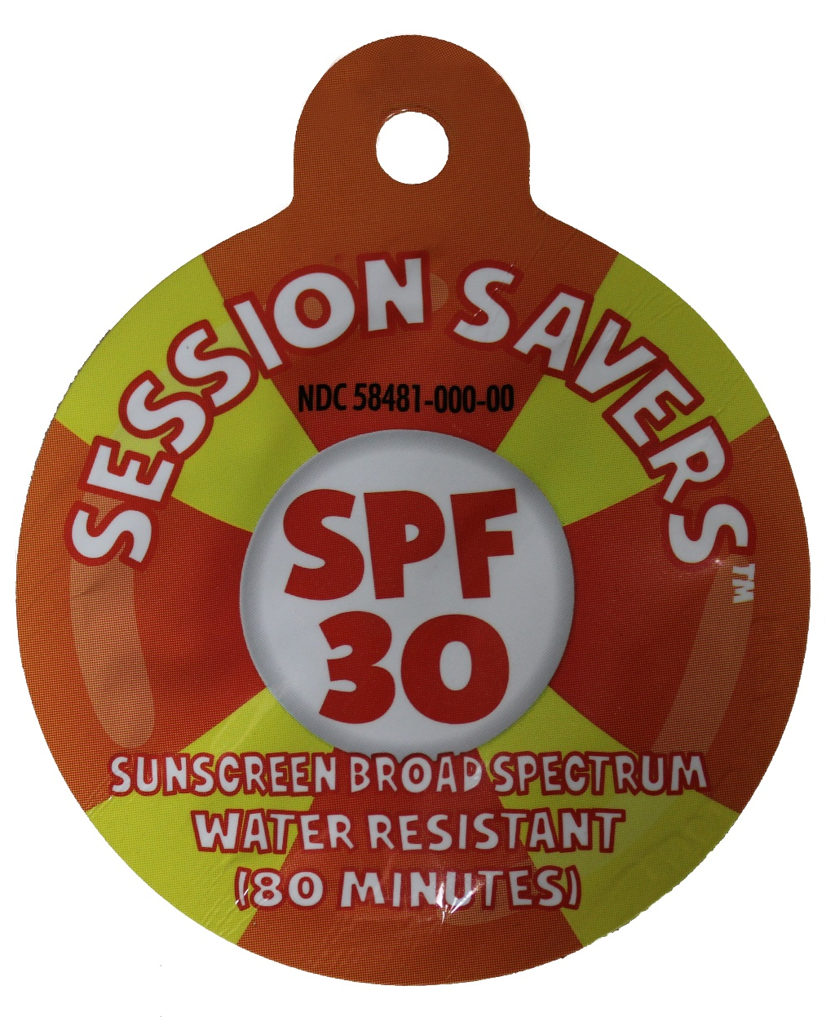
Vision and Goals
Vision: To be the premier provider of single serve sunscreen in the USA.
Goals:
Sell to multiple established brands and improve their gross revenue and recognition
Build international presence
Partner with global brands to enhance skin cancer awareness

Slide 3
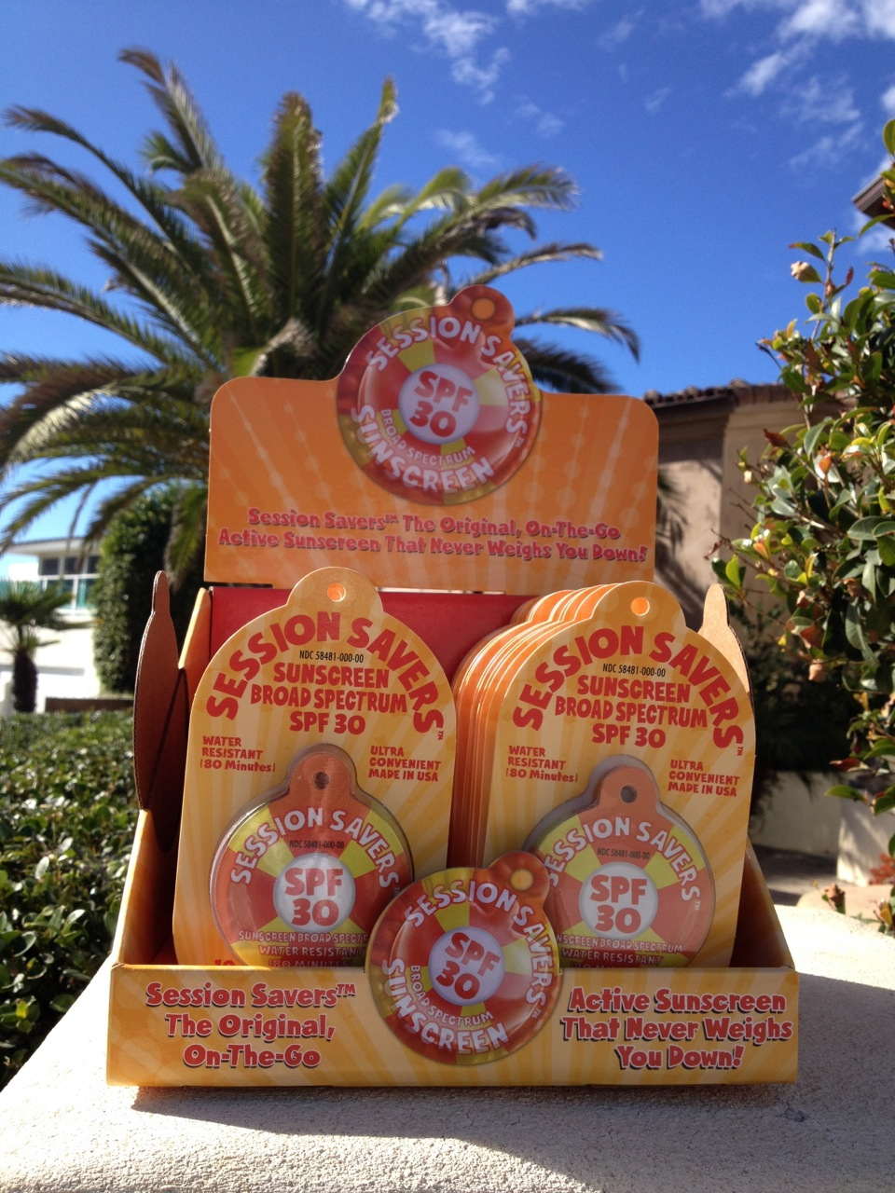
Session Savers
Sunscreen is:
The only single serve sunscreen on the market today.
It is designed to go anywhere.
And is simple to use.

Slide 4
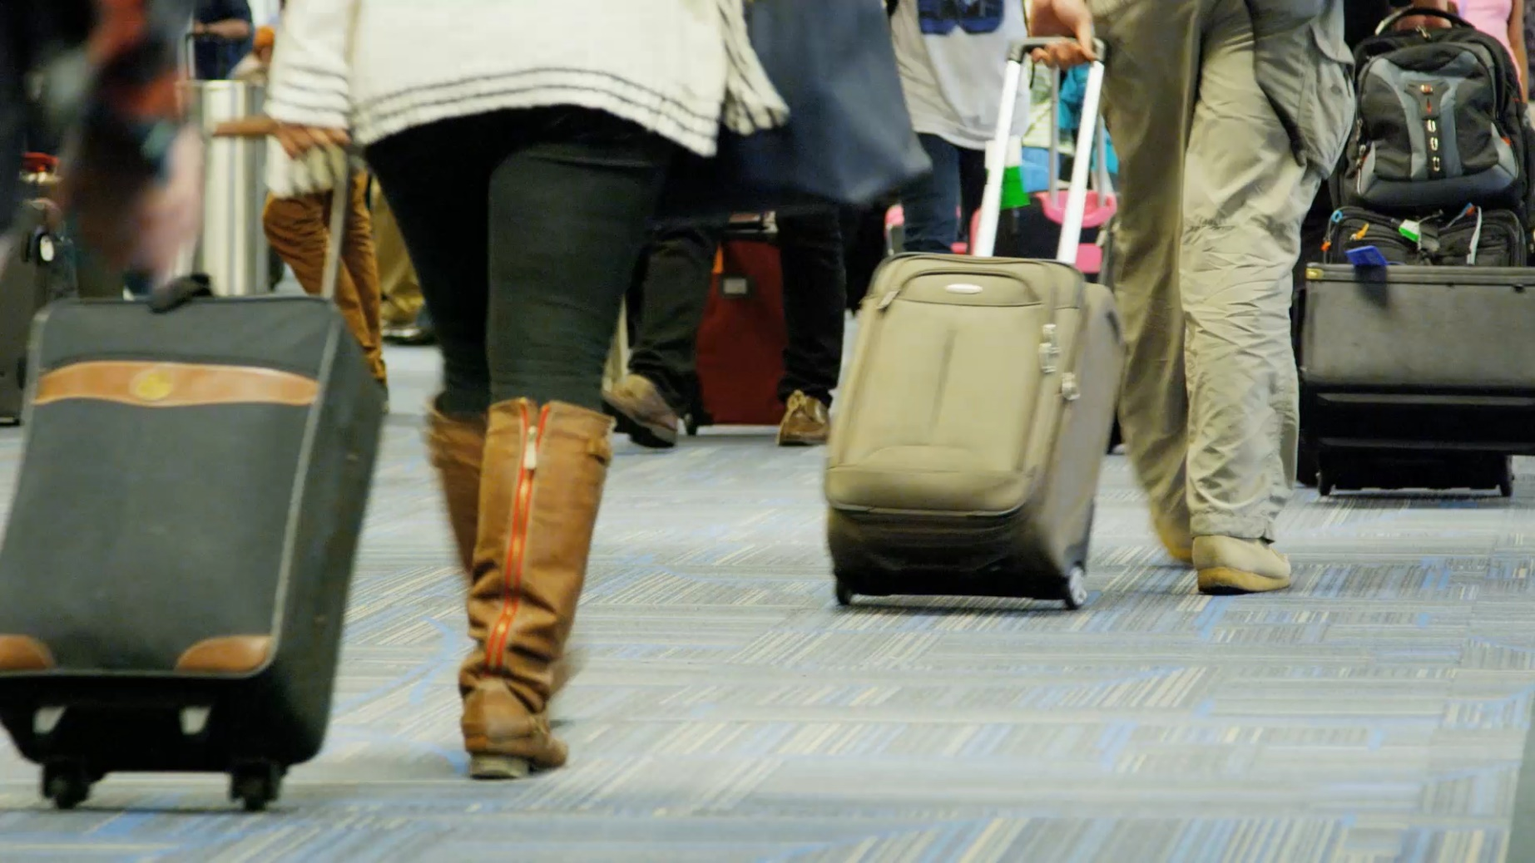
Session Savers is TSA approved so it can be brought on board in a carry on bag.

Slide 5
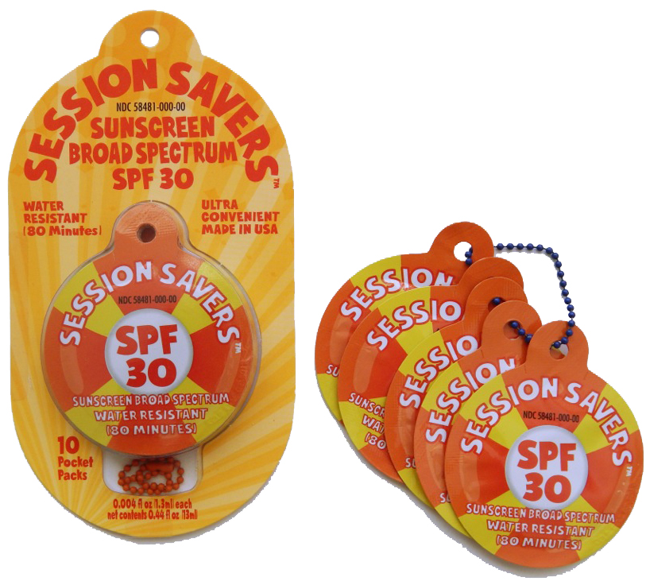
Every Retail Package Includes:
10 single-use sunscreen applications
One colorful carry-chain

Slide 6
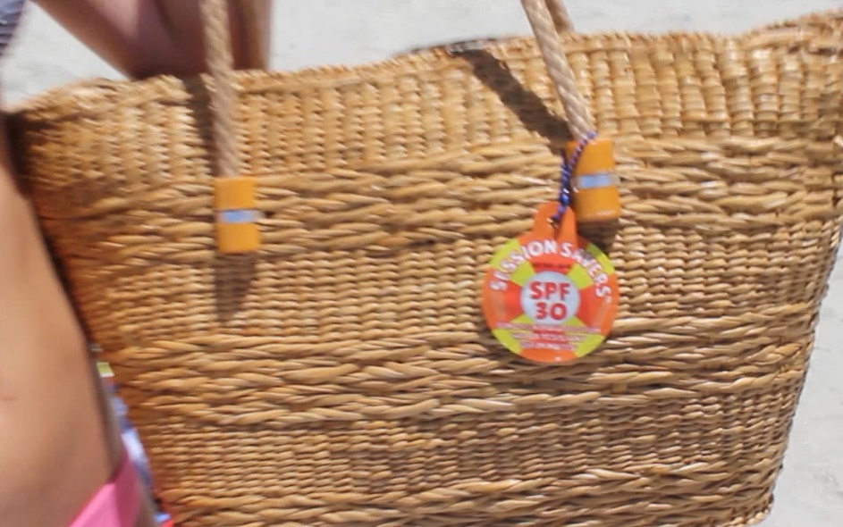
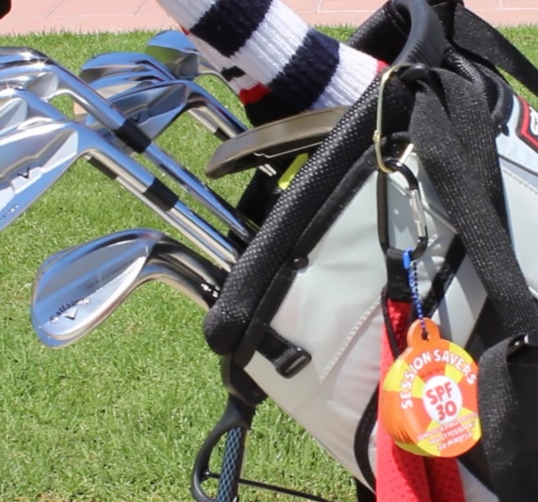
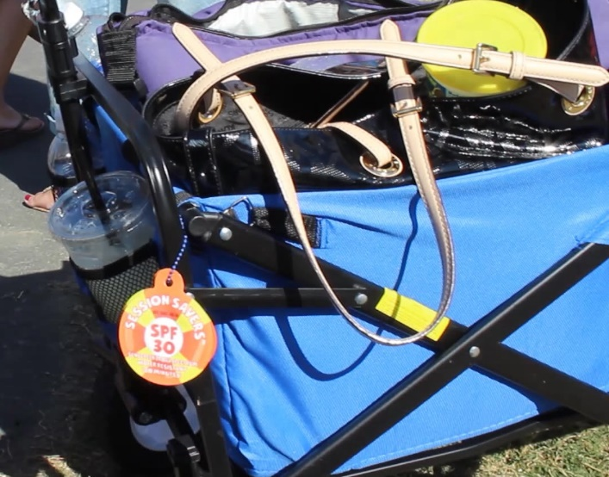
The single packages can be attached to clothing and gear to make this the most convenient Sunscreen on the market
It keeps the inside of bags clean from spillage and a
greasy bottle.

Slide 7
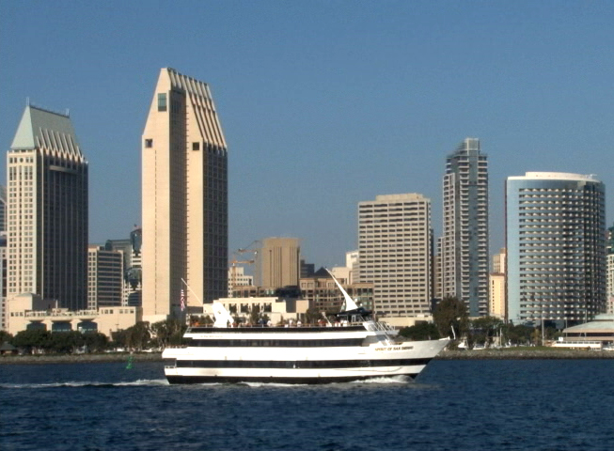
Made Entirely In The USA!!
Session Savers Sunscreen is
headquartered in
San Diego, California
Owned by
President
John D. Burton
And
Treasurer,
Jim Edwards

Slide 8
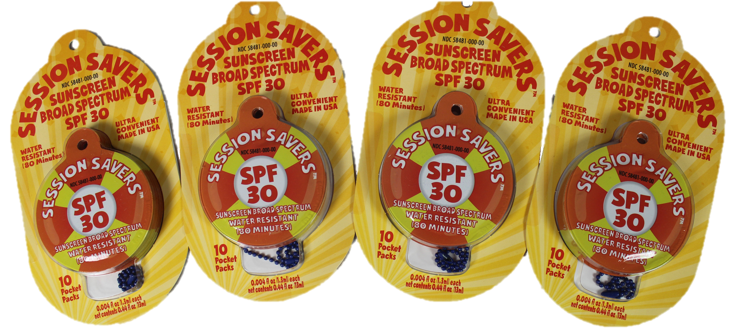
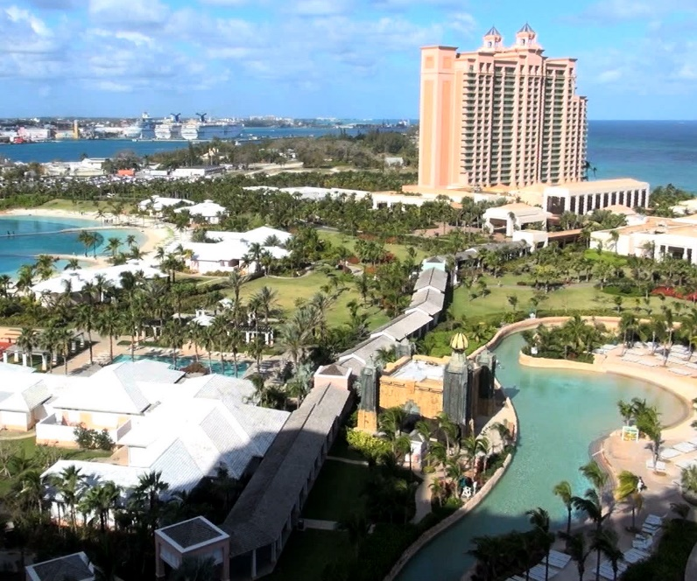
Unique packaging requires little shelf space and great margins
Perfect for
Hotel Vending Machines

Slide 9
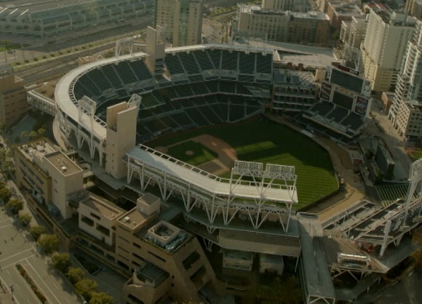
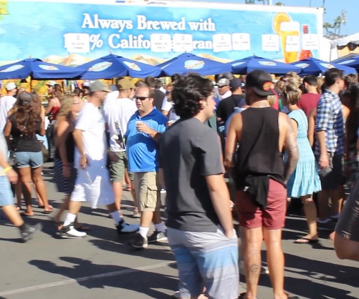
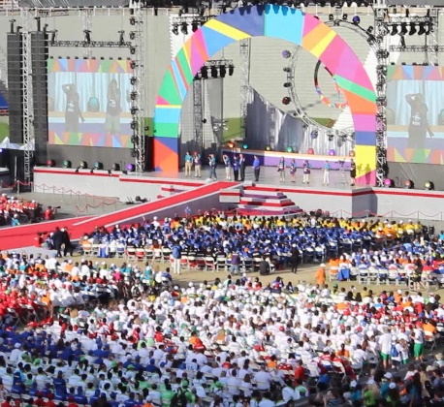
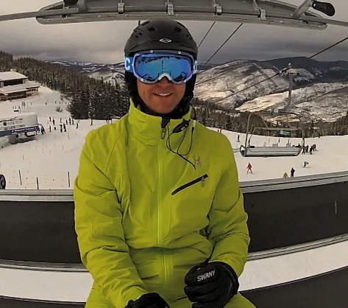
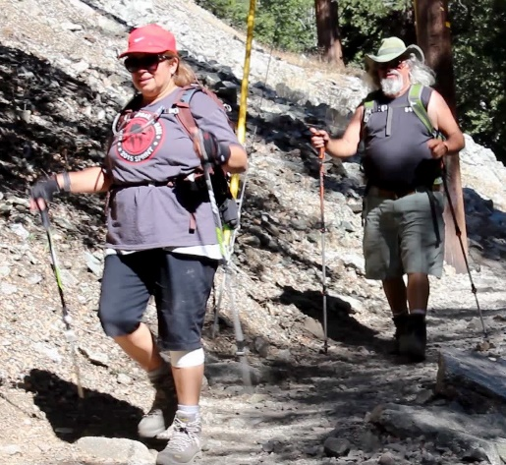
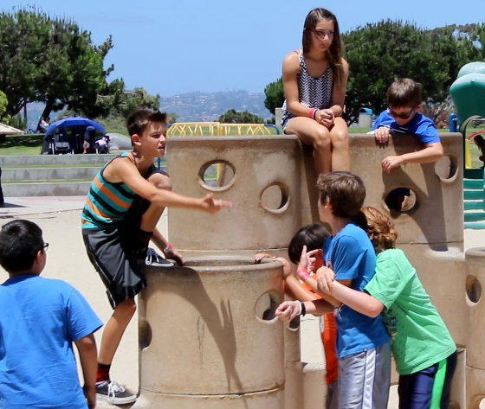
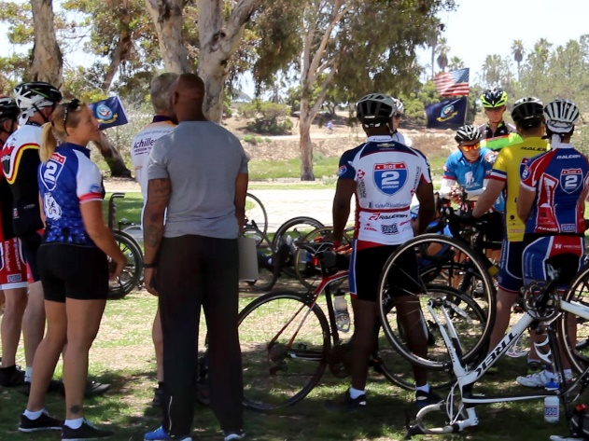
Session Savers is perfect for:
Stadium Sports
Festivals
Concerts
Ski Slopes
Hiking
Parks
Outdoor Adventures

Slide 10
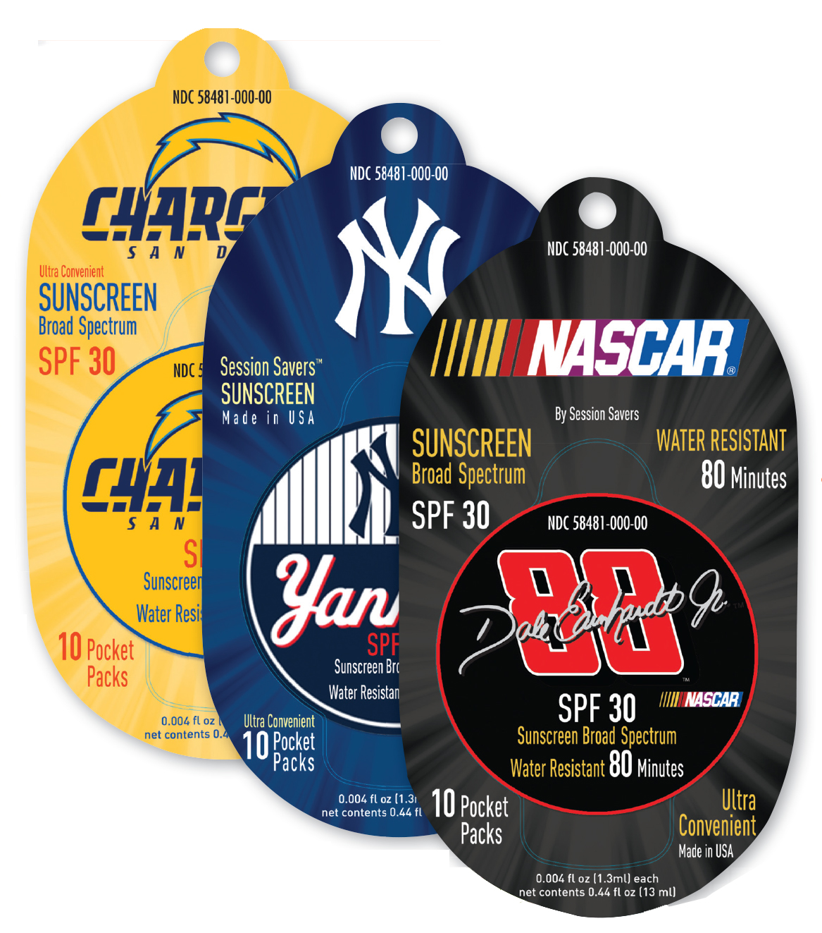
Session Savers is a natural for Licensing and Private Labels
For Professional Sports, Resorts, Parks and anywhere large crowds are outside.

Slide 11
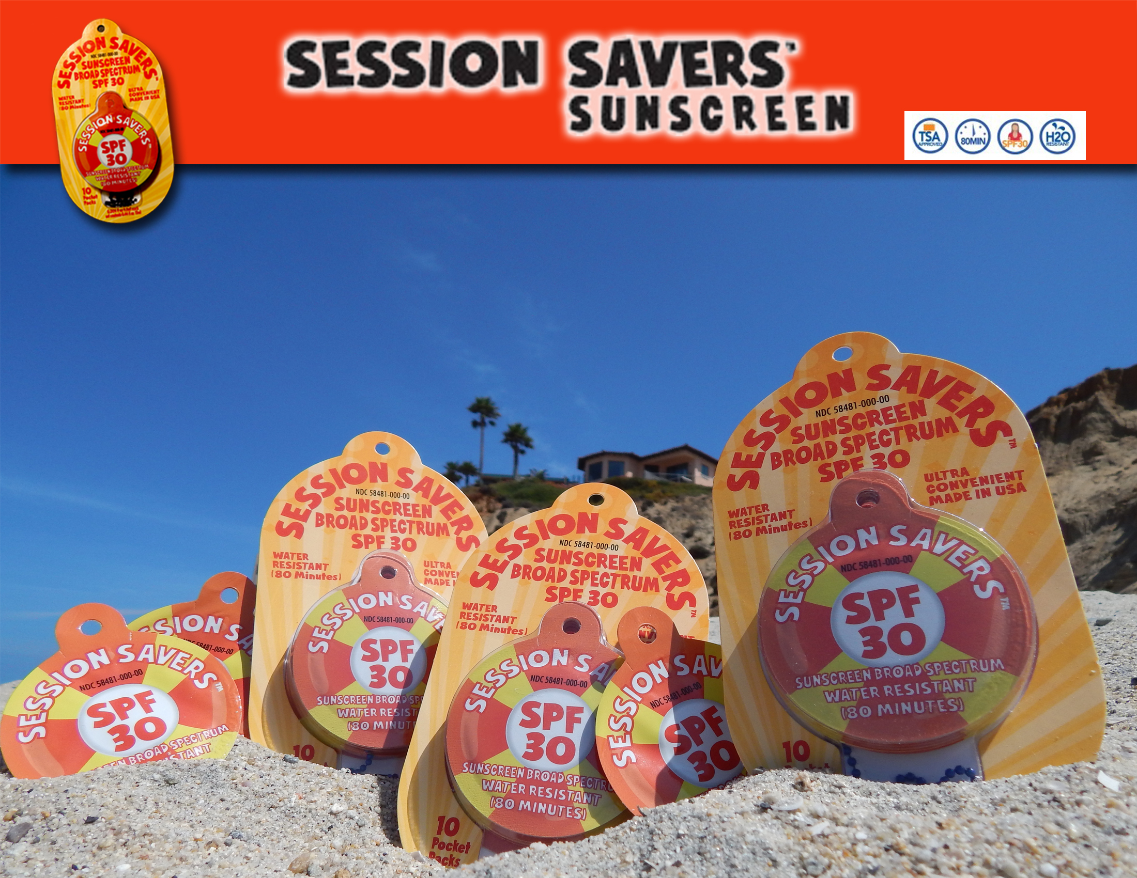
For More Information:
John@SessionSaversSunScreen.com v 619-764-2393
www.SessionSaversSunScreen.com
For More Information:
John@SessionSaversSunScreen.com v 619-764-2393
www.SessionSaversSunScreen.com

